Slide 1
Introduction to Lifestyle Medicine
Notes:
Welcome and hello! We’re so excited you’re here and interested in learning about his amazing field called Lifestyle Medicine! Let’s begin!

Slide 2
What Is Lifestyle Medicine?
Notes:
Some of you may be asking- what is lifestyle medicine anyway? That’s a great question!

Slide 3
What is Lifestyle Medicine?
“The evidence-based practice of helping individuals and families adopt and sustain healthy behaviors that affect health and quality of life.”
American College of Lifestyle Medicine, 2020
Notes:
According to the American College of Lifestyle Medicine, it is “The evidence-based practice of helping individuals and families adopt and sustain healthy behaviors that affect health and quality of life.”
Sounds pretty good, huh?

Slide 4
Why is Lifestyle Medicine Important?
“Lifestyle practices and health habits are among the nation’s most important health determinants. Changing unhealthy behaviors is foundational to medical care, disease prevention, and health promotion.”
American College of Lifestyle Medicine, 2020
Notes:
Per the ACLM Website: lifestyle practices and health habits are among the nation’s most important health determinants. Changing unhealthy behaviors is foundational to medical care, disease prevention, and health promotion. The clinician’s trusted relationship with the patient, with the support of the family, an interdisciplinary team and the community, is key to improving health behaviors and outcomes.

Slide 5
The Field of Lifestyle Medicine
Notes:
The field itself is fairly new. Its agenda is straightforward. Firmly state the link between lifestyle and health outcomes. We use science and well accepted psychological theories to help foster behavior change. There are 6 pillars of lifestyle medicine-
Adopting a nutrient-dense, plant-predominate eating pattern.
Optimizing and individualizing physical activity plans.
Improving sleep.
Managing stress with healthy coping strategies.
Forming and maintaining relationships.
Cessation of tobacco use and other unhealthy habits.
We value lifestyle recommendations as much as medications by writing prescriptions---like exercise prescriptions.
This field is one that recognizes the importance of other health professionals—we don’t just rely on the physicians. Many different kinds of healthcare professionals can become board certified in Lifestyle Medicine.

Slide 6
A Quick Trip Back in History
Notes:
In order to understand why lifestyle medicine is important in our society today, we must be knowledgeable about our current state of health in the US and the reasons we are where we are today. Let’s take a quick look at how we got here- and what “here” even means.

Slide 7
Major Advances that Changed Access to Food
Notes:
From the first gas powered tractor, that allowed one person to operate the machine rather than 4-5 on a steam-powered tractor, to crop rotation, pesticides, and genetically modified organisms- these inventions allowed farmers to grow for longer seasons and achieve a larger harvest. These advances increased efficiency and productivity while decreasing toil. They also increased food supply and availability of food, and decreased the need to sweat/ work hard to produce food.

Slide 8
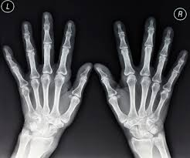
Health Advances that Changed the World
Childs and Kansagra, 2007
Notes:
Parallel to these advancements, healthcare has also developed over the years.
Long ago, surgery was an agonizing experience. When William T. G. Morton began using ether to dull pain during surgery in 1846, and surgery was changed forever. Since then, patients have been more willing to undergo the knife when necessary.
X-Rays were discovered by Wilhelm Conrad Rontgen, and is one of the biggest medical discoveries in history. With X-rays, scientists could see into the bodies of patients tn find problems and their causes without cutting.
In 1928 Alexander Fleming discovered penicillin, one of the ﬁrst antibiotics. As a result, life expectancy has risen. Bacterial infection causes far fewer problems for people today.
Birth Control Pills were developed in the 1960s and helped spur a revolution for woman liberation. Since then, women have had more freedom to plan their lives at work and at home by regulating their fertility.
These advances have led to less infectious disease, better healthcare, and longer lives.
.com/Health/TenWays/story?id=3605442&page=3 http://abcnews.go.com/Health/TenWays/story?id=3605442&page=3

Slide 9
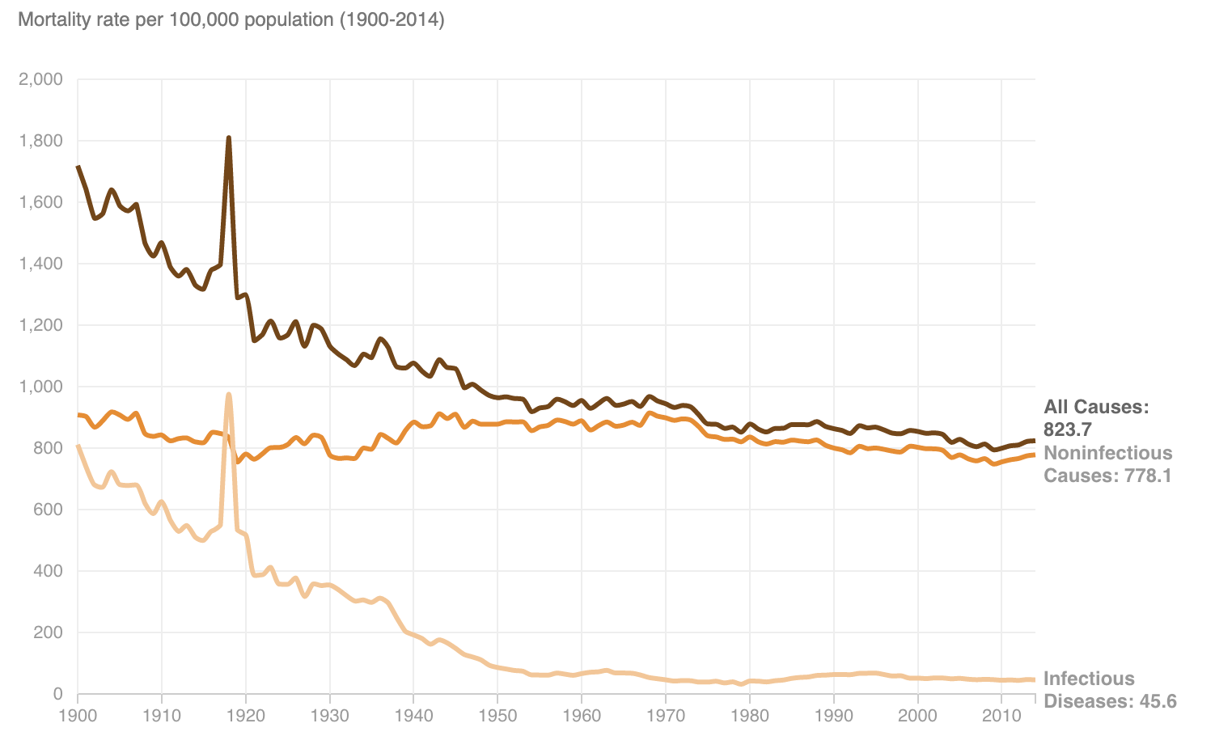
US Death from Infectious Disease
Hanson et al, 2016
Notes:
Death from infectious disease has decreased exponentially as medical advances have provided us with better care- from antibiotics to vaccines to sepsis protocols and sterile surgical fields. Infectious disease is no longer the leading cause of death, as it once was.

Slide 10
The State of US Health Today
Notes:
Now that know the history, let’s take a look at where we are today

Slide 11
Major Causes of Death in U.S.: 2018 Statistics
Heart disease: 647,457
Cancer: 599,108
Accidents (unintentional injuries): 169,936
Chronic lower respiratory diseases: 160,936
Stroke (cerebrovascular diseases): 146,383
Alzheimer's disease: 121,404
Diabetes: 83,564
Centers for Disease Control and Prevention, 2018
Notes:
Most up to date CDC data as of April 2020. Infectious disease (Influenza and Pneumonia) don’t even make the top 5 causes of US death any longer. Diseases in red have a decreased incidence in populations implementing lifestyle medicine principles.

Slide 12
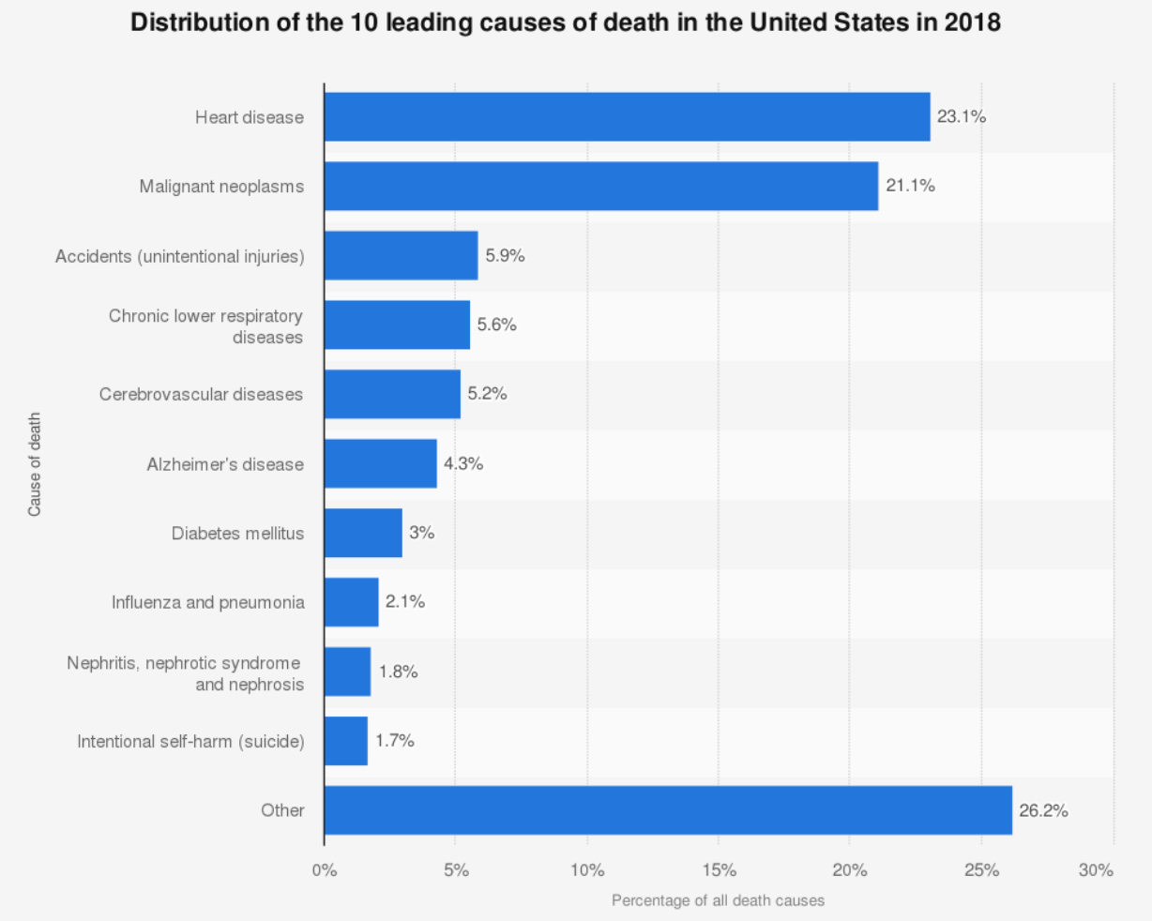
Elflein, 2020
Notes:
For those of you who are more graphically inclined… As you can see, infectious disease has fallen to 8th. However, chronic diseases, like heart disease, cerebrovascular disease, and diabetes have gradually climbed higher.

Slide 13
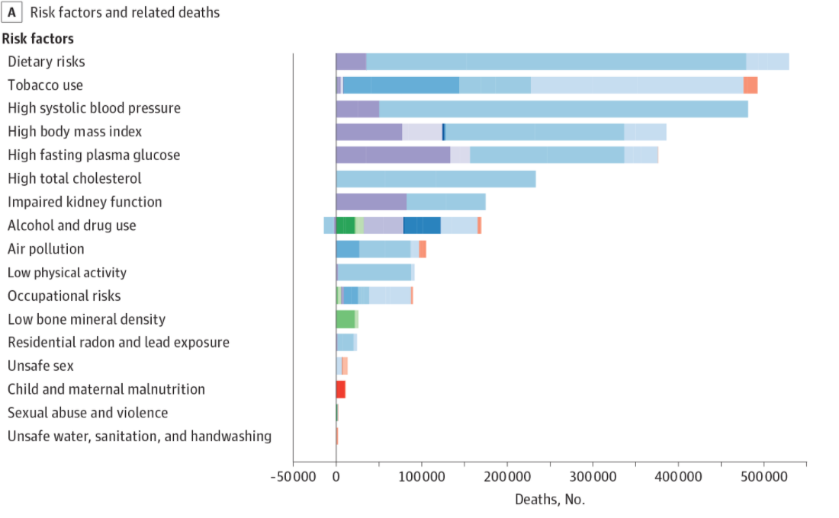
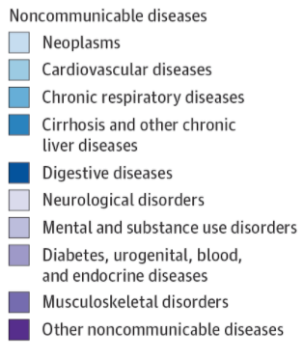
The State of US Health 1990-2016
The US Burden of Disease Collaborators, 2018
Notes:
Let’s take a slightly different approach to looking at these numbers- on the last slide you saw the top 10 leading causes of death in the US. Now let’s look at the 17 Leading Risk Factors for death in the United States. As you can see, dietary risks, tobacco use, high blood pressure, and elevated BMI make up the top 4 risk factors, reinforcing the pandemic of chronic disease in the US.
The Principles of lifestyle medicine work to reduce many of these risk factors- including but not limited to dietary risks and tobacco and alcohol use- leading to decreases in blood pressure, BMI, fasting plasma glucose, and a host of other biomarkers. You can see why in today’s day and age, the principles of lifestyle medicine are needed. Later, we’ll talk about some evidence that proves beyond a doubt these simple principles can truly impact our health. But for now- let’s finish our discussion about the state of health in the US.

Slide 14
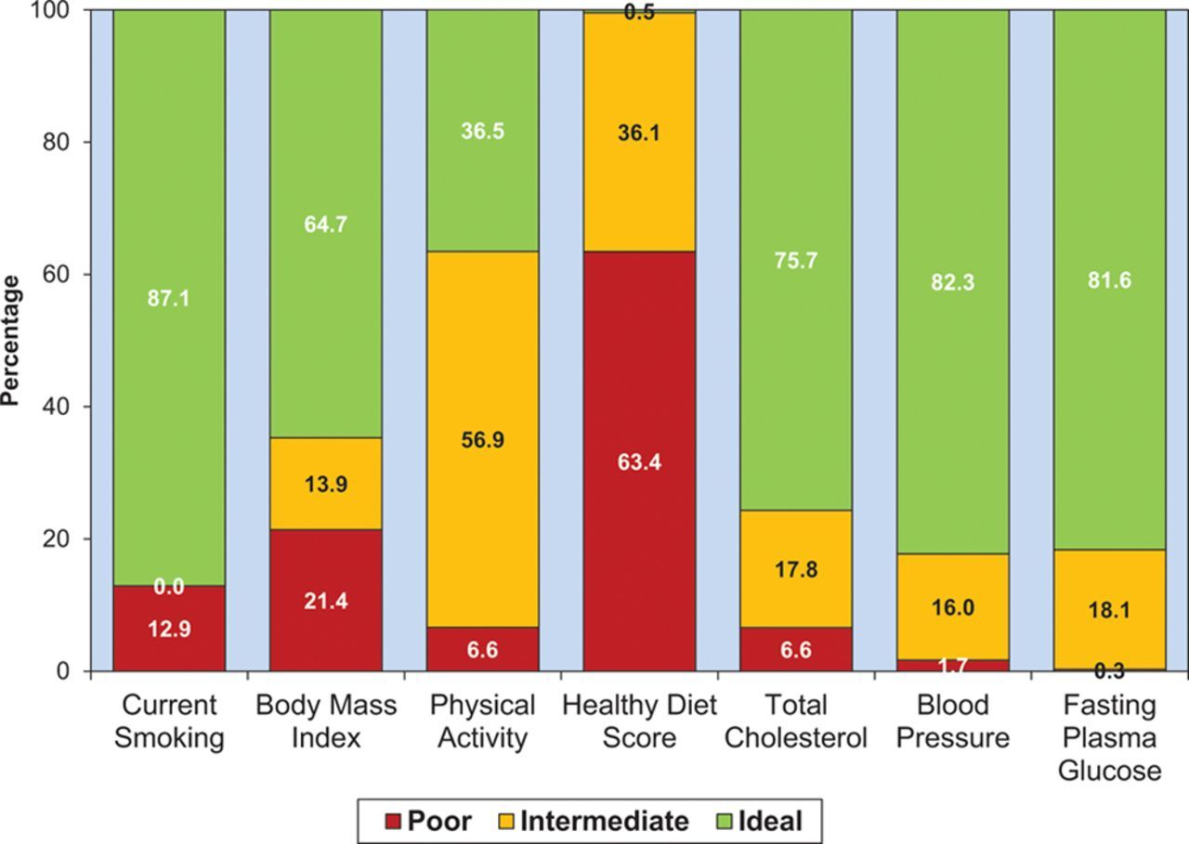
Prevalence for CV Risk Factors in US Adults 2016
Mozaffarian, Benjamin, Go, Arnett, Blaha, Cushman, & Turner, 2016
Notes:
Another way to look at risk factors- the American Heart Association created this graph on the prevalence of cardiovascular risk factors in US adults from data collected from the National Health and Nutrition Examination Survey (2016).
On the X axis is the listing of risk factors. On the Y axis is the percentage of US adults. The colored bars represent different levels of control. The green bars are ideal control of that risk factor. The yellow bars are intermediate control, and the red bars are poor control.
Look at the graph for a moment. Let your eyes wander to the bars that have the greatest amount of red. Now find the areas with the least amount of red.
What strikes you? I was struck by the fact that the smallest red bars were on the right hand side of the graph and that those were risk factors for which we
have a full armamentarium of drugs to help with treatment and control. Whereas I noticed that the risk factors with the largest red bars are those that are related to lifestyle- Healthy diet score, PA, BMI, smoking.
There is no magic pill to help us eat a healthy diet or to get us to exercise. This means that if we want to reduce mortality from CV disease and increase CV health in this country, we should focus on lifestyle and address those risk factors we have the poorest control over.
This graph clearly demonstrates that there is a gap in our ability to control 4 out of 7 CV disease risk factors and lifestyle modification can help fill that gap.
Chart 2-2. Age-standardized prevalence estimates for poor, intermediate, and ideal cardiovascular health for each of the 7 metrics of cardiovascular health in the American Heart Association 2020 goals, among US adults aged 􏰃20 years, National Health and Nutrition Examination Survey (NHANES) 2005–2006 (baseline available data as of January 1, 2010).

Slide 15
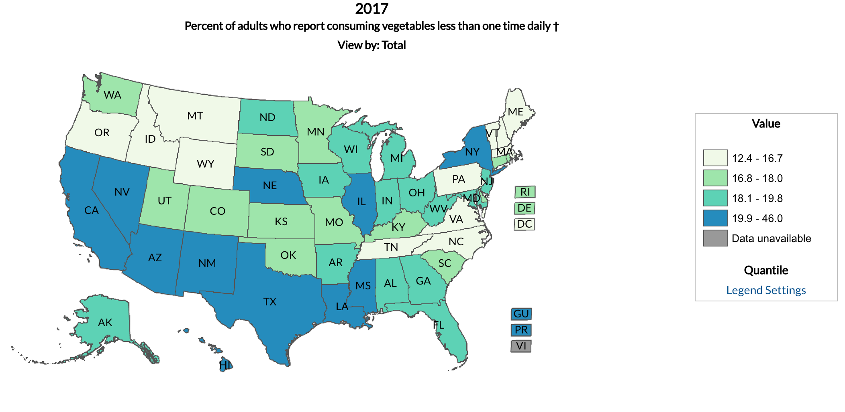
Vegetable Intake in U.S.
DNPAO Data, 2017
Notes:
Another way to look at this risk factor is to examine the daily vegetable intake of American Adults in different states as calculated by the CDC.
The dark blue states are those that have the most adults reporting they eat less than 1 serving of vegetables a day.
Now, this puts that healthy diet column into perspective.

Slide 16
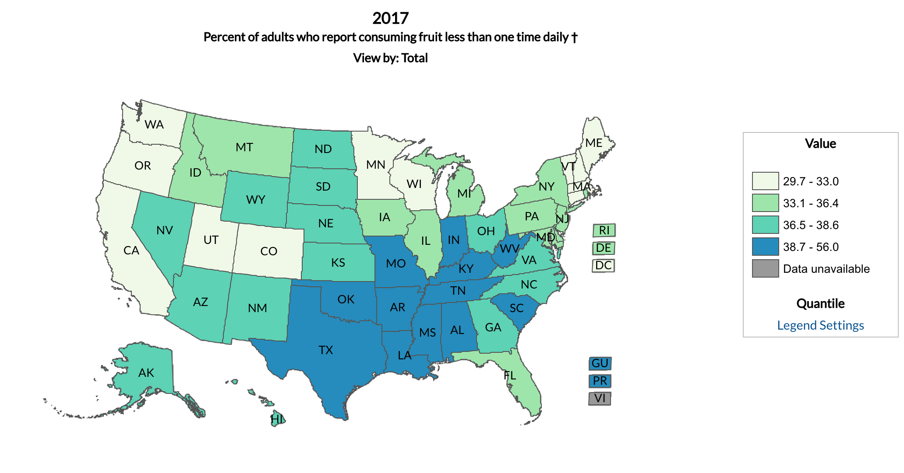
Fruit Intake in the U.S.
DNPAO Data, 2017
Notes:
You can see similar trends in the US fruit intake.

Slide 17
Physical Activity Levels in U.S.
American Institute for Cancer Research, 2020
Notes:
Let’s consider another one of the risk factors over which we seem to have poor control… the 2018 CDC finds only 23% of US adults meet federal recommendations for aerobic and muscle-strengthening activity
(150 minutes weekly of moderate activity and at least 2 days per week of muscle-strengthening activities.)
Nationally, the data shows that 23% meet the goals, but individual states vary from as few as 14.6% adults meeting guidelines to a high of 32.5%.
While a more physically demanding occupation can contribute to more activity, the researchers said that regardless of occupation, those who do leisure-time physical activity report better health than those who do not.

Slide 18
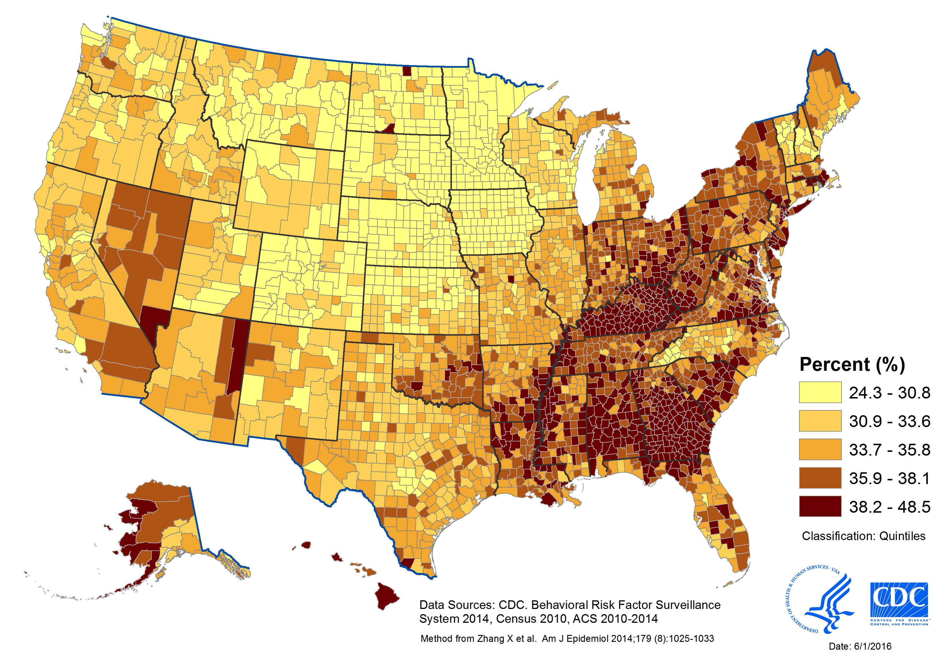
Short Sleep Duration in U.S.
https://www.cdc.gov/sleep/pdf/surveillance/SAE_County_2014_Sleep_508tagged.pdf
Center for Disease Control and Prevention, 2016
Notes:
The CDC aimed to collect data on percentage of US population that reported short sleep duration. The prevalence of Short Sleep Duration of less than 7 hours/day in adults 18 years and older by county in the United States from 2010-2014. Data published in 2016.
https://www.cdc.gov/sleep/pdf/surveillance/SAE_County_2014_Sleep_508tagged.pdf

Slide 19
How Can Lifestyle Medicine Help Solve Chronic Disease?
Notes:
Let’s take quick step back. Now we know where we are in terms of healthcare (shift of death burden from infectious disease to chronic disease which is now a HUGE issue that is killing THOUSANDS of people in the US each year) and why (easy access to food, higher calorie density of foods). Now let’s take a closer look as to how the pillars of LIfestyle Medicine can address these issues.

Slide 20
5 Healthy Habits Study
No Smoking
BMI< 25 kg/m2
Eat > 5 servings of fruits and vegetables per day
One or less alcoholic drink per day
>150 minutes of exercise per week
King, Mainous III, Carnemolla, Everett, 2009
Notes:
The 5 Healthy Habits study, published in the American Journal of Medicine, compared the rates of obesity and adherence to these 5 healthy habits in adults from 1988-1994 and adults 2001-2006. These 5 healthy habits nicely parallel some of the foundational pillars of lifestyle medicine (so when you see 5 healthy habits, think pillars of lifestyle medicine)

Slide 21
Comparison of Adherence to Healthy Lifestyle Habits in US Adults 1988-1994 and 2001-2006
King, Mainous III, Carnemolla, Everett, 2009
Notes:
This is the table of results from that study… as you can see, BMI definitely increased between 1988-1994 and 2001-2006.

Slide 22
Highlights from the 5 Healthy Habits Study
Obesity increased from 28% to 36%
Regular physical activity decreased from 53% to 43%.
Eating 5 or more fruits and vegetables a day decreased from 42% to 26%.
Adherence to all 5 healthy habits has gone from 15.8 % to 8.2%.
King, Mainous III, Carnemolla, Everett, 2009
Notes:
It is clear from the study that adherence to any and all of the 5 healthy habits between 1988-1994 and 2001-2006 decreased precipitously, while obesity skyrocketed. Let’s take a closer look at the increasing prevalence of obesity.

Slide 23
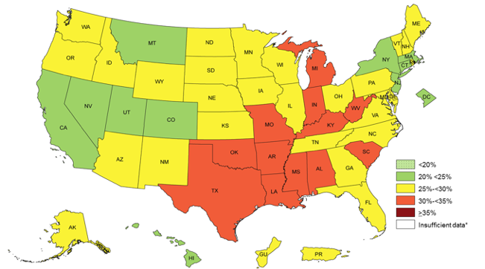
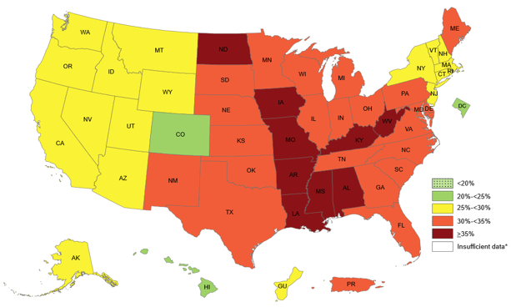
Adult Obesity Prevalence Maps
2011
2018
Centers for Disease Control and Prevention, 2020
Notes:
The American Medical Association officially recognized obesity as a disease in June 2014, a move that should have convinced physicians to pay more attention to the condition and spur more insurers to pay for treatments.
There is an obesity epidemic and it is only getting worse, despite all our medications and procedures we now have available to us. Two years ago, in 2018 it was noted that we were in a worse place than we were in 2011, as a nation.
Things aren’t getting better. According to the CDC, in 1990 we were starting to collect the data and noted that several states had what was deemed at that time a “large percent” (10-14%) of people in the obese category-BMI greater than or equal to 30. 10-14% obesity rates for a state would today be considered low.
From 2011, you can clearly see that many states experienced an increase in the number of obese inhabitants. The yellow states have 25-29% of their population classified as obese, the orange states 30-35%, and dark red have over 35% of the population classified as obese. These statistics seem grim, but there is a sparkle of hope for the health of our nation.

Slide 24
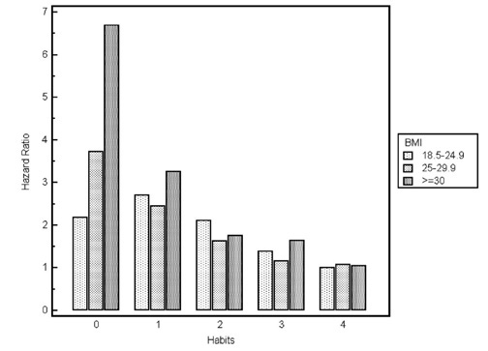
Lifestyle Habits and Mortality in Overweight Individuals
Eating 5 or more fruits and vegetables daily, exercising regularly (at least 12 times in a month), alcohol in moderation, not smoking
Matheson, King, Everett, 2012
Notes:
So now we know that obesity in the US is increasing, while adherence to the 5 healthy habits are decreasing... but let’s take a closer look at how correlated these two facts really are. As you can see from this graph, which was created from the data of the 1988-1994 cohort, a lower BMI is strongly correlated with adherence to more of the 5 healthy habits. But lifestyle medicine doesn’t just combat obesity, it does so much more!

Slide 25
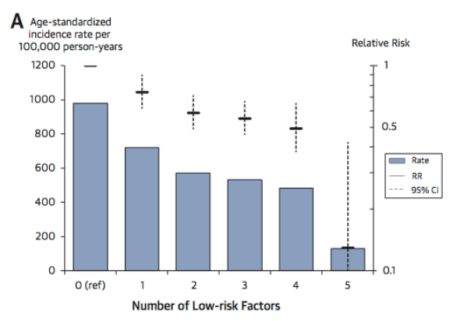
Healthy Behavior Impact on Incidence of MI in Men
Akesson, Larsson, Discacciati, Wolk, 2014
Notes:
Here is a graph is from a population-based, prospective cohort of Swedish men comprised 45- to 79-year-old men who completed a detailed questionnaire on diet and lifestyle at baseline in 1997. The questionnaire assessed similar information to the 5 healthy habits, but called them “low-risk factors”: a healthy diet (top quintile of Recommended Food Score), moderate alcohol consumption (10 to 30 g/day), no smoking, being physically active (walking/bicycling ≥40 min/day and exercising ≥1 h/week), and having no abdominal adiposity (waist circumference <95 cm). The researchers then followed these 20,721 men for 13 years and recorded the incidence of heart attacks.
The results show that for every additional low- risk behavior , the men in this study were less likely to suffer a myocardial infarction over the 13 years of follow up in the study. This study found almost 4 of 5 MIs in men may be preventable with a combined low-risk behavior.
Not only are these principles directly fighting obesity, they ALSO may be able to prevent 4 out of 5 heart attacks?!? There is NO drug in the world with such proven efficacy.
Objectives The aim of this study was to examine the benefit of combined low-risk diet and healthy lifestyle practices on the incidence of MI in men.
Methods The population-based, prospective cohort of Swedish men comprised 45- to 79-year-old men who completed a detailed questionnaire on diet and lifestyle at baseline in 1997. In total, 20,721 men with no history of cancer, cardiovascular disease, diabetes, hypertension, or high cholesterol levels were followed through 2009. Low-risk behavior included 5 factors: a healthy diet (top quintile of Recommended Food Score), moderate alcohol consumption (10 to 30 g/day), no smoking, being physically active (walking/bicycling ≥40 min/day and exercising ≥1 h/week), and having no abdominal adiposity (waist circumference <95 cm).
Results During 11 years of follow-up, we ascertained 1,361 incident cases of MI. The low-risk dietary choice together with moderate alcohol consumption was associated with a relative risk of 0.65 (95% confidence interval [CI]: 0.48 to 0.87) compared with men having 0 of 5 low-risk factors. Men having all 5 low-risk factors compared with those with 0 low-risk factors had a relative risk of 0.14 (95% CI: 0.04 to 0.43). This combination of healthy behaviors, present in 1% of the men, could prevent 79% (95% CI: 34% to 93%) of the MI events on the basis of the study population.
Conclusions Almost 4 of 5 MIs in men may be preventable with a combined low-risk behavior.

Slide 26
Coronary Artery Disease Risk Factors
High blood cholesterol and triglyceride
High blood pressure
Diabetes
Overweight and obesity
Smoking
Lack of physical activity
Unhealthy diet
Stress
Coronary Heart Disease, n.d.
Notes:
It’s important to remember that all these health benefits that come from lifestyle medicine are tied together- lowering your BMI to a healthy range decreases your fat, which decreases your risk for diabetes, which decreases risk for coronary artery disease, which decreases your risk for a heart attack. These chronic diseases are not separate entities when they are happening inside one body- they impact one another and lead to increased morbidity and mortality. What an amazing thing then, that a few simple principles have the power to tackle so many correlated diseases at once.
We’ve talked about obesity and heart disease, and shown what lifestyle medicine has the power to do- now let’s dive into diabetes- another leading chronic disease lifestyle medicine has the tools to tackle.

Slide 27
Prevalence of Diabetes and Obesity by County 2004
https://www.cdc.gov/diabetes/data/center/slides.html
Diabetes and Obesity Maps. Centers for Disease Control and Prevention.
Notes:
Diabetes and Obesity tied together. This graph is from 2004, we’re going to compare it to the following map from 2016.
Diagnosed Diabetes (%): Low (<9.0), Mid (9.0–13.9), High (>13.9); Obesity (%): Low (<29.1), Mid (29.1–36.0), High (>36.0) THIS MEANS OVER ⅓ OF THE POPULATION IN THE COUNTY IS OBESE! Let’s remember back to the beginning of the presentation when, in 1990, a “high” obesity rate meant 10-14%!

Slide 28
Prevalence of Diabetes and Obesity by County 2016
Diabetes and Obesity Maps. Centers for Disease Control and Prevention.
Notes:
Diagnosed Diabetes (%): Low (<9.0), Mid (9.0–13.9), High (>13.9); Obesity (%): Low (<29.1), Mid (29.1–36.0), High (>36.0) THIS MEANS OVER ⅓ OF THE POPULATION IN THE COUNTY IS OBESE!
As you can see this has become a rapidly growing problem in the US. The problem has only continued over the last several years.

Slide 29
Diabetes Prevention Program
Landmark Study funded by NIH, published in 2002 in the New England Journal of Medicine
Reduction in the Incidence of Type 2 Diabetes with Lifestyle Intervention or Metformin
3234 non diabetic patients with elevated fasting and post-load plasma glucose levels
Randomly assigned to placebo, Metformin, or lifestyle intervention
Diabetes Prevention Program Research Group, 2002
Notes:
So- how do we combat this ever growing epidemic of diabetes? Let’s talk about a landmark study funded by the NIH and published in the New England Journal of Medicine. Researchers randomly assigned 3234 nondiabetic persons with elevated fasting and post-load plasma glucose concentrations to placebo, metformin (850 mg twice daily), or a lifestyle-modification program with the goals of at least a 7 percent weight loss and at least 150 minutes of physical activity per week and followed them for 4 years (average of 2.8 years) to measure incidence of diabetes.
BACKGROUND
Type 2 diabetes affects approximately 8 percent of adults in the United States. Some risk factors — elevated plasma glucose concentrations in the fasting state and after an oral glucose load, overweight, and a sedentary lifestyle — are potentially reversible. We hypothesized that modifying these factors with a lifestyle-intervention program or the administration of metformin would prevent or delay the development of diabetes.
METHODS
We randomly assigned 3234 nondiabetic persons with elevated fasting and post-load plasma glucose concentrations to placebo, metformin (850 mg twice daily), or a lifestyle-modification program with the goals of at least a 7 percent weight loss and at least 150 minutes of physical activity per week. The mean age of the participants was 51 years, and the mean body-mass index (the weight in kilograms divided by the square of the height in meters) was 34.0; 68 percent were women, and 45 percent were members of minority groups.
RESULTS
The average follow-up was 2.8 years. The incidence of diabetes was 11.0, 7.8, and 4.8 cases per 100 person-years in the placebo, metformin, and lifestyle groups, respectively. The lifestyle intervention reduced the incidence by 58 percent (95 percent confidence interval, 48 to 66 percent) and metformin by 31 percent (95 percent confidence interval, 17 to 43 percent), as compared with placebo; the lifestyle intervention was significantly more effective than metformin. To prevent one case of diabetes during a period of three years, 6.9 persons would have to participate in the lifestyle-intervention program, and 13.9 would have to receive metformin.
CONCLUSIONS
Lifestyle changes and treatment with metformin both reduced the incidence of diabetes in persons at high risk. The lifestyle intervention was more effective than metformin.

Slide 30
Lifestyle Intervention Details
Lose 7% of initial body weight
Low calorie, low fat diet
150 minutes of moderate intensity physical activity per week
16 lesson curriculum covering diet, exercise, and behavior modification
Taught by case managers
Flexible
Individualized
Subsequent- individual (monthly) and group sessions
Diabetes Prevention Program Research Group, 2002
Notes:
The lifestyle intervention group included losing 7% of initial body weight by following a low calorie low fat diet, incorporating 150 minutes of moderate physical activity per week, and a 16 lesson curriculum covering diet, exercise, and behavior modification. What are the results you ask?

Slide 31
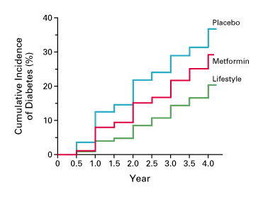
Lifestyle Counseling: Does It Work? Diabetes Prevention Program
31%
58%
Diabetes Prevention Program Research Group, 2002
Notes:
The study was terminated one year early because the results were so robust.
The incidence of diabetes was 11.0, 7.8, and 4.8 cases per 100 person-years in the placebo, metformin, and lifestyle groups, respectively. The lifestyle intervention reduced the incidence by 58 percent (95 percent confidence interval, 48 to 66 percent) and metformin by 31 percent (95 percent confidence interval, 17 to 43 percent), as compared with placebo; the lifestyle intervention was significantly more effective than metformin. To prevent one case of diabetes during a period of three years, 6.9 persons would have to participate in the lifestyle-intervention program, and 13.9 (almost twice as many) would have to receive metformin.

Slide 32
The Financial Side
Notes:
So now we understand how lifestyle medicine can combat, cure, and reverse the leading chronic illnesses of obesity, cardiovascular disease, and diabetes. Now let’s take a look at how these principles impact the business side of medicine.

Slide 33
Health Care Costs in 2018
$3.6 trillion overall
$11,172 per person
Top five most expensive conditions:
heart disease, cancer, trauma, mental disorders, and pulmonary conditions
Top 5% of spenders responsible for 50% of healthcare costs:
Most suffering from chronic diseases
http://www.cms.gov/Research-Statistics-Data-….
Notes:
U.S. health care spending grew 4.6 percent in 2018, reaching $3.6 trillion or $11,172 per person. As a share of the nation's Gross Domestic Product, health spending accounted for 16.9 percent. One of the most amazing statistics is that the top 5 most expensive medical conditions are responsible for 50% of healthcare costs.

Slide 34
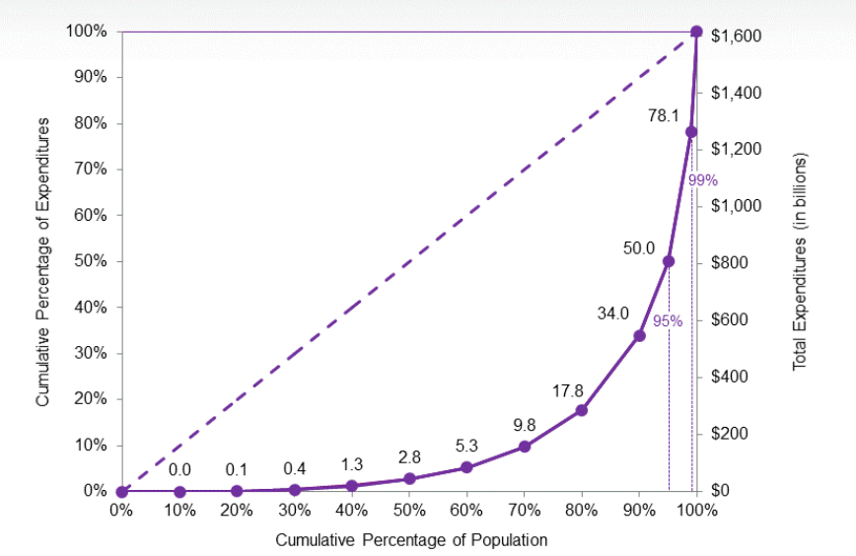
Where does this money go?
Mitchell, 2019
Notes:
Here is a graph which demonstrates the percentage of healthcare expenditure vs. the percentage of the population. The top 5% of spenders account for almost half of spending, the top 1% of spenders account for more than 20% of spending. Data from 2016.

Slide 35
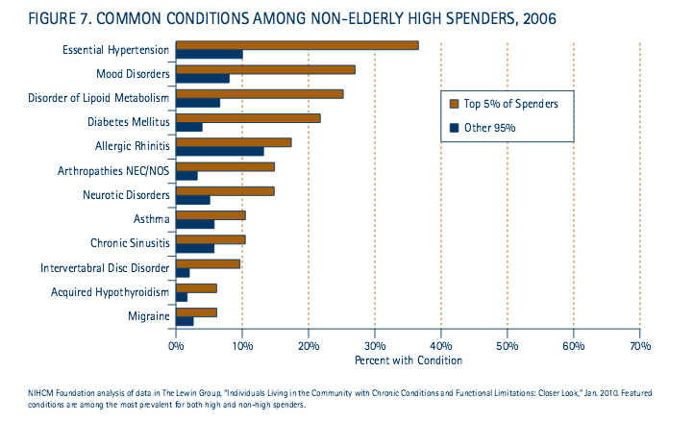
Schoenman, 2012
Notes:
Unsurprisingly, the top 5% of spenders ALSO have many of the chronic diseases we’ve seen earlier- from hypertension to diabetes, the top 5% have significantly higher rates of disease.

Slide 36
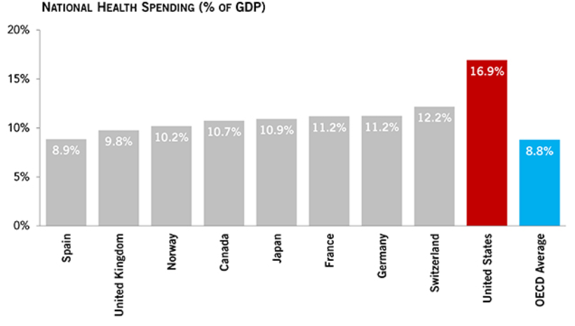
Healthcare Costs in US are Significantly Higher than Comparable Countries
How Does the U.S. Healthcare System Compare to Other Countries?. (2019). Peter G. Peterson Foundation. https://www.pgpf.org/blog/2019/07/how-does-the-us-healthcare-system-compare-to-other-countries
Notes:
If you’re thinking these numbers ($11,172 per person) are crazy, you’re right! We spend a significantly higher percentage of our GDP on healthcare than our counterparts.

Slide 37
American Public Health Association
What percentage of healthcare dollars are spent on prevention?
3%
What percent of our healthcare costs are related to preventable conditions?
75%
Reducing the prevalence of hypertension in the US by just five percent would save the economy
$25 billion annually
http://www.apha.org
https://www.hhs.gov/surgeongeneral
Notes:
Despite spending more than twice what most other industrialized nations spend on health care, the U.S. ranks 24th out of 30 such nations in terms of life expectancy. A major reason for this startling fact is that we spend only 3 percent of our health care dollars on preventing diseases (as opposed to treating them), when 75 percent of our health care costs are related to preventable conditions.

Slide 38
How We Can Make A Difference
Notes:
Let’s talk about how we, as healthcare providers, can help patients live out these pillars!

Slide 39
Efficacy of Healthcare Counseling
In a 2008 study of hypertensive patients, what % received counseling to engage in physical activity as a way to manage their hypertension?
Halm and Amoako, 2008
Notes:
In a study of 669 hypertensive patients, what % received counseling by a health care professional to engage in physical activity as a way to manage their hypertension?
Background: Achieving normal blood pressure with antihypertensive medication remains an achievable goal for only approximately equal to 31% of hypertensive patients. Physical activity is a primary lifestyle measure required to lower blood pressure in hypertensive patients, and the US Preventative Services Task force (USPSTF) recommends counseling by health care providers to promote regular physical activity. Surveys of patients suggest, however, that few healthcare providers follow the USPSTF recommendation on physical activity counseling.
Method: This article examined data on the rate of healthcare provider counseling, compliance with recommendations and the blood pressure difference associated with following recommendations to increase physical activity. Data are from the National Health and Nutritional Examination Survey III 1988-1994 (NHANES-III) of adults with hypertension. We compared the results of compliance with recommendation from the NHANES-III data to five recent clinical trials on physical activity conducted between 1991 and 2001.
Results: A third of the NHANES-III hypertensive patients received counseling to engage in physical activity to manage their hypertension, and 71% (n=669) followed the recommendations and had a systolic blood pressure that was an average of approximately equal to 3-4 mm Hg lower than those who did not follow recommendations.
Conclusion: This study shows that fewer patients are receiving exercise counseling to help lower blood pressure and improve health outcomes. However, patients seem to follow the advice when given. Given the magnitude of poorly controlled hypertension, these findings should alert healthcare providers to find innovative means of physical activity recommendation to improve health outcomes.

Slide 40
Efficacy of Healthcare Counseling
In a 2008 study of hypertensive patients, what % received counseling to engage in physical activity as a way to manage their hypertension?
33%
Halm and Amoako, 2008
Notes:
Only 33% of hypertensive patients received counseling to engage in physical activity as a way to manage their hypertension.

Slide 41
Efficacy of Healthcare Counseling
In a 2008 study of hypertensive patients, what % received counseling to engage in physical activity as a way to manage their hypertension?
Of the patients who were counseled, what % followed the recommendations to exercise and reduced their blood pressure?
Halm and Amoako, 2008

Slide 42
Efficacy of Healthcare Counseling
In a 2008 study of hypertensive patients, what % received counseling to engage in physical activity as a way to manage their hypertension?
Of the patients who were counseled, what % followed the recommendations to exercise and reduced their blood pressure?
71%
Halm and Amoako, 2008
Notes:
Of this 33%, 71% took this advice to heart and made real lifestyle changes! Healthcare providers need to be harnessing the power of lifestyle medicine, but this means we can’t be afraid to practice it. We need to be competent.

Slide 43
There is Minimal Training on Exercise & Nutrition Counseling in Medical School
1975- “Will Physicians of the Future be Able to Prescribe Exercise?”
71% of medical schools fail to meet the minimum recommendation of 25 hours of nutrition education
36% provided 12 or fewer hours,
9% provided no nutrition education at all.
Adams et al, 2015
Notes:
The concept of the exercise prescription is not new. Interestingly, exercise prescriptions pop into the medical literature starting in 1975 with this article from Journal of Medical Education
The American College of Sports Medicine and the American Medical Association have popularized this term with their Exercise is medicine campaign. ACLM has also worked to make exercise prescriptions routine.
Back 35 years ago, 16% of medical schools offered a course (not a core or required course) but a course geared to exercise as preventive medicine. Now, 82% of medical schools do not require students to take any physical activity related courses, and on average only offer 19.6 hours of nutrition education.

Slide 44
6 Pillars of Lifestyle Medicine
Notes:
6 pillars of lifestyle medicine- nutrition (whole food plant based diet), exercise (>150 minutes/ week), cessation of tobacco and reduction of alcohol use, quality sleep, stress management, and fostering social connectivity. The future of healthcare- and something we need to be learning about in our schools!

Slide 45
What Can We Do?
Notes:
Now that we understand the state of health in the US, the principles of Lifestyle Medicine, and how these principles can prevent and reverse the chronic diseases plaguing our country-- what should we do now?!

Slide 46
Become Part of the LM Movement
Join the American College of Lifestyle Medicine (ACLM) and connect with others passionate about LM!
Plus, tons of additional membership benefits!
www.lifestylemedicine.org
Notes:
Hyperlink 1: http://www.lifestylemedicine.org/Membership-Application
Hyperlink 2: http://www.lifestylemedicine.org/Membership-Benefits
Hyperlink 3: http://www.lifestylemedicine.org/Why-Join
Hyperlink 4: http://www.lifestylemedicine.org/INTEREST-GROUPS
Hyperlink 5: https://vimeo.com/143219257

Slide 47
Start a Lifestyle Medicine Interest Group
For trainees, we encourage you to become a member and get involved in spreading LM to campuses nationwide!
Start your own Trainee Interest Group!
Lifestyle Medicine Interest Group (LMIG) Starter Kit and Introductory Video available online
www.lifestylemedicine.org
Notes:
Hyperlink 1: http://www.lifestylemedicine.org/INTEREST-GROUPS

Slide 48
Interested in Diving Deeper into LM and Advancing the Field?
There is a special award for Trainees
The Donald Anderson Pegg Award for innovative research and inspiring projects in LM.
Please go to the ACLM website for further information.
Teams of students can apply and attendings/mentors are encouraged to get involved, as well.
www.lifestylemedicine.org
Notes:
Hyperlink 1 & 2: http://www.lifestylemedicine.org/Annual-Awards#DonaldAndersonPeggAwardforYoungLifestyleMedicineInnovators

Slide 49
Join Us!
The Lifestyle Medicine Conferences are a great way to get connected with other healthcare professionals that are passionate about improving the lives of others through lifestyle medicine!
Come connect with colleagues and hear from LM visionaries to learn about current, evidence-based LM practices.
LMConference.org
Notes:
Hyperlink 1: lmconference.org

Slide 50
Special Thanks To Our Authors
Elizabeth Pegg Frates, MD
Assistant Professor, Part Time, Harvard Medical School (HMS)
Faculty, Psych E 1037-Introduction to Lifestyle Medicine
Harvard Extension School
Founder and Faculty Advisor, Lifestyle Medicine Interest Group at HMS
Board Liaison for Professionals in Training (PiT),
American College of Lifestyle Medicine (ACLM)
Jonathan Bonnet, MD, CAQSM Kate Simeon
Slides reviewed and updated by: Gia Merlo, MD, MBA, DipABLM
Cheryl True, MD, DipABLM, FACLM
Marie Dacey, EdD
Jenny S. Lee, PhD, MPH, DipIBLM, FACLM
Aneeha Dalal
Erica Veazey, BS

Slide 51
References
Adams KM, Butsch WS, Kohlmeier M. The State of Nutrition Education at US Medical Schools. J Biomed Educ. 2015;2015:1-7. doi:10.1155/2015/357627.
American College of Lifestyle Medicine. (2020). Mission Vision. Retrieved from https://www.lifestylemedicine.org/ACLM/Lifestyle_Medicine/What_is_Lifestyle_Medicine/ACLM/About/What_is_Lifestyle_Medicine_/Core_Competencies.aspx?hkey=26f3eb6b-8294-4a63-83de-35d429c3bb88edi
American Institute for Cancer Research. (2020). Few US Adults Meet Physical Activity Guidelines For Health, Cancer Prevention - American Institute For Cancer Research. Retrieved from https://www.aicr.org/resources/blog/few-us-adults-meet-physical-activity-guidelines-for-health-cancer-prevention/
Akesson, A., Larsson, S.C., Discacciati, A., Wolk, A. (2014). Low-risk diet and lifestyle habits in the primary prevention of myocardial infarction in men: a population-based prospective cohort study. Journal of the American College Cardiology, 64(13), 1299‐1306. doi:10.1016/j.jacc.2014.06.1190
Centers for Disease Control and Prevention. (2020). Prevalence of Self-Reported Obesity Among U.S. Adults by State and Territory. Retrieved from https://www.cdc.gov/obesity/data/prevalence-maps.html.
Centers for Disease Control and Prevention. (2018). Data table for Figure 2. Number of deaths, percentage of total deaths, and age-adjusted death rates for all causes and the 10 leading causes of death in 2018: United States, 2017 and 2018. Retrieved from https://www.cdc.gov/nchs/data/databriefs/db355_tables-508.pdf#page=2
Childs, D. and Kansagra S. (2007 Sept 20). 10 Health Advances that Changed the World. ABC News. Retrieved from https://abcnews.go.com/Health/TenWays/story?id=3605442&page=3//abcnews.go

Slide 52
References Continued
Coronary Heart Disease. (n.d.) National Heart, Lung, and Blood Institute. Retrieved from http://www.nhlbi.nih.gov/health/health-topics/topics/hd
DNPAO Data, Trends and Maps: Explore by Topic | CDC. nccd.cdc.gov. https://nccd.cdc.gov/dnpao_dtm/rdPage.aspx?rdReport=DNPAO_DTM.ExploreByTopic&islClass=FV&islTopic=FV1&go=GO. Published 2017.
Diabetes and Obesity Maps. Centers for Disease Control and Prevention. https://www.cdc.gov/diabetes/data/center/slides.html. Published October 31, 2018. Accessed June 5, 2020.
Diabetes Prevention Program Research Group. (2002). The New England Journal of Medicine, 346:393-403. doi: 10.1056/NEJMoa012512
Elflein, J. (2020). Leading Causes of Death in the United States 2018. Statista. Retrieved from https://www.statista.com/statistics/248619/leading-causes-of-death-in-the-us/
Halm J, Amoako E. (2008). Physical activity recommendation for hypertension management: Does healthcare provider advice make a difference? Ethnicity and Disease, 18(3): 278-82.
Hansen V, Oren E, Dennis LK, Brown HE. Infectious Disease Mortality Trends in the United States, 1980-2014. JAMA. 2016;316(20):2149–2151. doi:10.1001/jama.2016.12423

Slide 53
References Continued
How Does the U.S. Healthcare System Compare to Other Countries?. (2019). Peter G. Peterson Foundation. Retrieved from https://www.pgpf.org/blog/2019/07/how-does-the-us-healthcare-system-compare-to-other-countries
King, D.E., Mainous III, A.G., Carnemolla, M., Everett, C.J. (2009, June 1). The American Journal of
Medicine, 122, 528-534. Retrieved from https://doi.org/10.1016/j.amjmed.2008.11.013
Matheson E.M., King D.E., Everett C.J. (2012). Healthy lifestyle habits and mortality in overweight and obese individuals. J Am Board Fam Med, 25(1):9‐15. doi:10.3122/jabfm.2012.01.110164
Mitchell, E.M. (2019). Concentration of Health Expenditures and Selected Characteristics of High Spenders, U.S. Civilian Noninstitutionalized Population, 2016. Agency for Healthcare Research and Quality. Retrieved from https://meps.ahrq.gov/data_files/publications/st521/stat521.shtml
Mozaffarian, D.,Benjamin, E.J.,Go, A.S.,Arnett, D.J., Blaha,M.J., Cushman, M,..., Turner, M.B. (2016). Heart Disease and Stroke Statistics- 2016 Update. Circulation, 133:e38–e360. Retrieved from https://doi.org/10.1161/CIR.0000000000000350
Schoenman, J. (2012). The Concentration of Health Care Spending. National Institution for Health Care Management. Retrieved from http://www.nihcm.org/pdf/DataBrief3%20Final.pdf
The U.S. Burden of Disease Collaborators. (2018). The State of US Health, 1990-2016: Burden of Diseases, Injuries, and Risk Factors Among US States. JAMA. 319(14):1444–1472. doi:10.1001/jama.2018.0158

